Slide 1
Coastal Forcing Engine

Slide 2


Draft Structure Design
config.yaml
# -----------------------------------------------------------------------------
# User Configuration File for Coastal Forcing
#
# This file controls model type, hydrology source, meteo source,
# coastal water level source, domain selection, and output paths.
# -----------------------------------------------------------------------------
coastal_model: sfincs # Options: schism, sfincs
meteo_source: nwm_ana # Options: nwm_retro, nwm_ana
hydrology_source: nwm # Options: nwm, ngen
coastal_water_level_source: stofs # Options: stofs, tpxo, glofs (great lakes only)
domain_file: texas_example # Options: see domain_lists/{coastal_model}/
start_time: 2025-05-11T00-00-00Z # Simulation start time in format YYYY-MM-DDTHH-MM-SSZ
end_time: 2025-05-11T03-00-00Z # Simulation end time in format YYYY-MM-DDTHH-MM-SSZ
# These should be externally mounted raw_download_dir: ../data/raw/ # Directory for storing raw downloaded data
sim_dir: ../run/ # Directory for storing all processed model files ready to run
domain_lists
download_data
process_data

Slide 3
Draft Structure Design
config.yaml
Includes files that indicate where the (mostly) static model files are located, e.g.:
schism
domain_lists
all.yaml
# This file is intended to be an example of how one could list domains available #to run
domain:
- name: texas_example
path: ..\..\..\CoastalModels\sfincs\texas_example\ # path to base model files
region: texas # General region or basin group
notes: >
Example SFINCS domain covering an area of Texas coastline
download_data
process_data
sfincs
texas_example.yaml

Slide 4
Draft Structure Design
config.yaml
domain_lists
includes script to download raw data from required sources, for example NWM retrospective, NWM forecast, STOFS, etc. and saves them to raw_download_dir specified in config.yaml
download_data
process_data
data

Slide 5
Draft Structure Design
config.yaml
domain_lists
includes script to process the raw data into the format required by the model, and saves to forcing_output_data directory specified in config.yaml
download_data
process_data

Slide 6
Draft Structure Design
these should be externally mounted
coastalmodels
(“static” model files)
data
run
(temporary run folder)
coastalforcing
config.yaml
sfincs
raw
{model}_{simdate}
domain_lists
schism
download_data
process_data

Slide 7
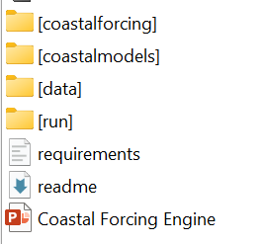
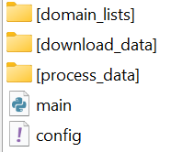
Main workflow script, calls:
download_data/data_downloader.py
functions for downloading raw forcing data
process_data/data_processor.py
functions for processing the raw data to the model specific input format
saves the processed files to the simulation run folder
Then also copies the necessary base model simulation files to the simulation run folder, resulting in a folder with all needed simulation files ready to run

Slide 8
To meet AC, data_downloader needs to:
Download nwm retrospective streamflow if hydrology_source = nwm and meteo_source = nwm_retro
Downlowd nwm retrospective atmospheric data if meteo_source = nwm_retro
Download nwm AnA cycle streamflow if hydrology_source=nwm and meteo_source = nwm_ana
Download nwm AnA cycle atmospheric data if meteo_source = nwm_ana
Download STOFS if coastal_water_level_source = stofs
Download GLOFS if coastal_water_level_source = glofs
Download NOAA observations within domain
For the time period specified by start_time, end_time
Main workflow script, calls:
download_data/data_downloader.py
functions for downloading raw forcing data
process_data/data_processor.py
functions for processing the raw data to the model specific input format
saves the processed files to the simulation run folder
Then also copies the necessary base model simulation files to the simulation run folder, resulting in a folder with all needed simulation files ready to run

Slide 9
To meet AC, data_processor needs to:
Process nwm retrospective streamflow if hydrology_source = nwm and meteo_source = nwm_retro
Process nwm retrospective atmospheric data if meteo_source = nwm_retro
Process nwm AnA cycle streamflow if hydrology_source=nwm and meteo_source = nwm_ana
Process nwm AnA cycle atmospheric data if meteo_source = nwm_ana
Process ngen streamflow if hydrology_source = ngen (from wherever this is on OE already???)
Process STOFS if coastal_water_level_source = stofs
Process GLOFS if coastal_water_level_source = glofs
Process TPXO if coastal_water_level_source = tpxo (from wherever this is on OE already???)
For the time period specified by start_time, end_time
Copy all processed files to the simulation run folder
Main workflow script, calls:
download_data/data_downloader.py
functions for downloading raw forcing data
process_data/data_processor.py
functions for processing the raw data to the model specific input format
saves the processed files to the simulation run folder
Then also copies the necessary base model simulation files to the simulation run folder, resulting in a folder with all needed simulation files ready to run

Slide 10
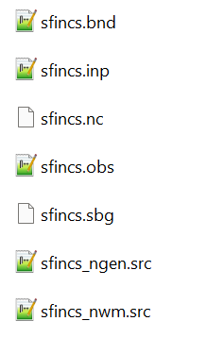
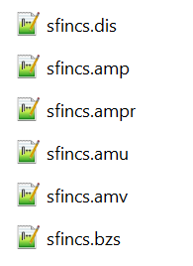
To meet AC, main workflow script needs to:
Copy (mostly) static files into the simulation run folder (the “base model files”)
Main workflow script, calls:
download_data/data_downloader.py
functions for downloading raw forcing data
process_data/data_processor.py
functions for processing the raw data to the model specific input format
saves the processed files to the simulation run folder
Then also copies the necessary base model simulation files to the simulation run folder, resulting in a folder with all needed simulation files ready to run
For SFINCS
Base model files
Forcing files
copy this one if hydrology_source = ngen
copy this one if hydrology_source = nwm

